Slide 1
Detection and Prevention of Fake News
Student Name:
ID:

Slide 2
Problem Statement And Analysis
Statement:
Detection (The Present Problem)
A huge amount of news data on digital platforms
Difficult detect unauthentic news by human
Automated tools are needed
Prevention (The Future Problem)
Complex network of users
Open access of data
Prevention from alteration or temperament needed
Have to control open access of data
Notes:
First, the problem can be divided into two sub categories, the present and future problem. The present problem refers to identify or detect the existing news as fake or real by an automated tool because a huge amount of data can be generated on digital platforms in every minute and that is difficult for humans to perform the task. Then due to complex network structure of users and open access of data on these platforms, it is important to identify the future problem which refers to prevent the authentic news form alteration or temperament.

Slide 3
Motivation
Propose A Hybrid Framework
Solving both of the problems (present & future)
To classify news
To store in a secured database
Using existing techniques as well as propose improvement
Machine Learning (Supervised learning classifier)
Block-chain (Immutable news source)
Improve and contribute to the research by providing
critical analysis
Efficient research plan
Evaluation techniques
Research outcome
Notes:
The motivation for this work is to propose a hybrid framework that solves both of problems mentioned in the previous slide by using existing techniques as well as propose improvement. This hybrid model will contain a machine learning model which will classify news by using supervised classification technique and a block-chain based secured data storage system which will ensure the prevention of authentic news and will be used as immutable news source. Our motivation is also to provide critical analysis with an efficient research plan. Evaluation techniques and research outcomes are also discussed to justify that our proposed framework is aligned with problem statement.

Slide 4
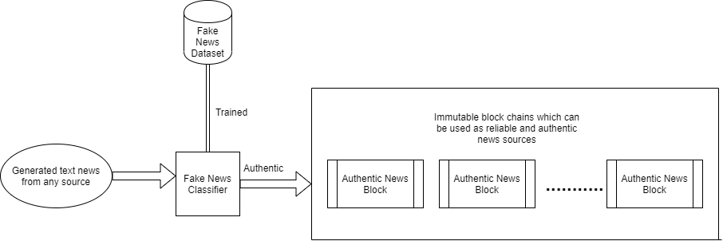
Proposed Framework Structure
Notes:
Our machine learning classifier will be able detect authentic or fake news after it is trained on a dataset consisting examples of fake and authentic news. Then the authentic news will be stored in a block-chain by using cryptographic hashing and peer-to-peer network which will be used as immutable news source.

Slide 5
Critical Analysis
Is the proposed framework feasible?
Yes
Aligned with the problem statement
Possible to automatically detect fake news based on features
Block-chain provides immutable data storage
Research Outcome:
Answers why spreading fake news is a problem
And why it should be solved by using automated technology
Provides insights about the techniques
Proposes improvements
Notes:
The critical analysis in the thesis provides the key research answers including the feasibility of the proposed work. The analysis provided proofs that the solution fulfils the problem requirements and aligns with the statement. Also this research provides answers like why spreading fake news is a problem and why it should be solved by using automated technology, why not humans, also contributed to the research by providing insights, implementation plans and improvements.

